Slide 1
Git & GitHub

Slide 2
Version control system
A way to manage files & directories
Track changes in your files over time
Allow you to revert any changes and go back to a previous state

Slide 3
git
Created by Linus Torvalds in April 2005
A command line version control system
It is open-source and cross platform
It track the changes

Slide 4
repository
It is most common word used when dealing with git.
Commonly called as “repo”.
Usually used to organize a single project
It can contain anything which your project needs

Slide 5
Git workflow
Initialize the git in your project:
git init
Add files to your project
Now, staging all the changes made in the project:
git add .
Commit the changes to the repo:
git commit –m “message goes here”
To check the commits log:
git log

Slide 6
Mostly used git commands
git init
git status
git log
git add
git commit
git diff
git rm
git mv
git branch
git checkout
git merge

Slide 7
Branching
Allows one to try new ideas
If an idea doesn’t work, throw away the branch
If it does work, merge the branch to the master

Slide 8
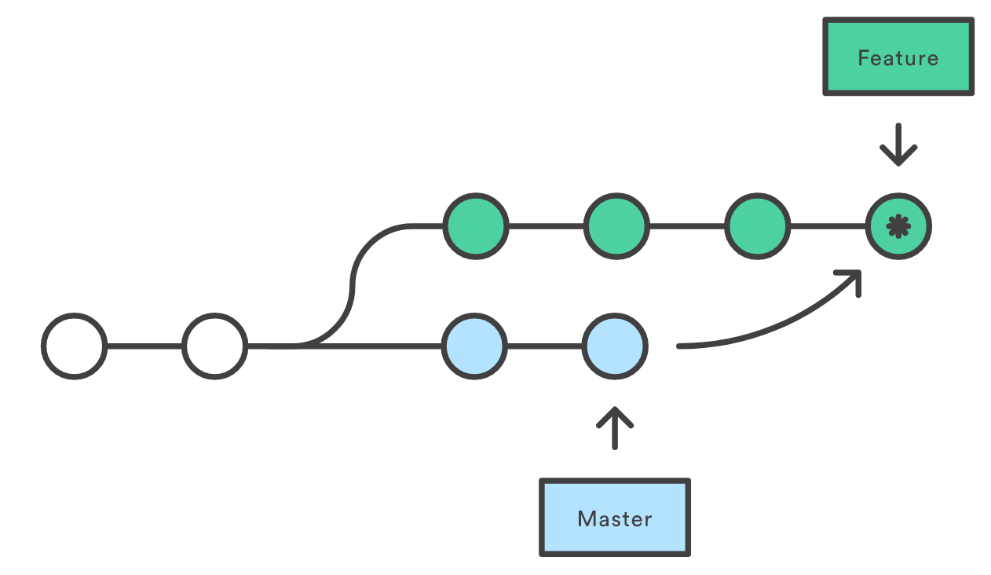
Branching & Merging

Slide 9
git merge branch_name
While merging, a merge conflict may occur
Example: there is a changes in the same line in two different commits
Git will show where the merge conflict has occurred.
You need to manually resolve it before merging
git merge –abort is used to abort the current merge

Slide 10
GitHub
A platform to host git repos
Launched in 2008
Most popular git host
Allow the user to contribute on projects from anywhere
Free to use

Slide 11
Linking local repo to a remote repo
To check which remote you project is link:
git remote
Linking new remote:
git remote add <alias> <URL>
Ex: git remote add origin git@github.com:example/myblog.git
Pushing to remote repo:
git push local_branch_name branch_name
Ex: git push origin master
Fetching from remote repo:
git fetch remote_repo_name

Slide 12
.gitignore file
The .gitignore file is the one where you add any files/folders name or path.
These files will remain untracked from the git.
Ex: In node js we don’t want to keep track of node_module folder or an env file you created.
These are the files that git doesn't know anything about, typically it ignores them.

